Slide 1

Unit 2 Model and Classifications
Mrs.Disha Sushant Wankhede
disha.wankhede@viit.ac.in
Department of Computer Engineering
BRACT’S, Vishwakarma Institute of Information Technology, Pune-48
(An Autonomous Institute affiliated to Savitribai Phule Pune University)
(NBA and NAAC accredited, ISO 9001:2015 certified)

Slide 2
Objective/s of this session
To Introduce FinTech and it’s sub sectors
To Explain the classification of various models of FinTech
To Describe the innovation in FinTech
To Introduce an innovative Fin Tech strategy
To Study the development of FinTech Application and about future trends in Fin Tech
After completion of the course, student will be able to
1. Understand what FinTech is and the sub sectors that comprise it.
2. Classify various models of the Fintech
3. Illustrate various innovations done using latest technology trends in FinTech.
4. State the Critical Success Factors in Fin Tech.
5. Be able to adopt an innovative Fin Tech strategy within their own organization to lead a digital transformation project.
6. Develop the application using the concepts of FinTech as a case study
Learning Outcome/Course Outcome
Department of Computer Engineering, VIIT, Pune-48

Slide 3
Unit 2 Contents
Part A :
Introduction,
Classification,
Five Ws and one H :
1. Why a fintech initiative was born?
2. For whom was it born?
3. Which are the services it aims to provide?
4. Where does it aim to perform its business?
5. When does it aim to operate, within the framework of the financial cycle?
6.How is fintech working?
Part B :
The organization and its elements,
The V4 business model framework,
A Business Model,
A Business Model for Fintech,
Revenue—Focus on Customer Lifetime Value, Components of an effective marketing plan.
Mrs.Disha Wankhede Department of Computer Engineering, VIIT, Pune-48

Slide 4

Top Indian fintech startups
Paytm
Paytm Money
PhonePe
MobiKwik
PayU
ETMoney
PolicyBazaar
LendingKart
Freecharge
Mswipe
ezetap
LoanTap
Billdesk
FINO PayTech
Capital Float
Pine Labs
Mrs.Disha Wankhede Department of Computer Engineering, VIIT, Pune-48

Slide 5
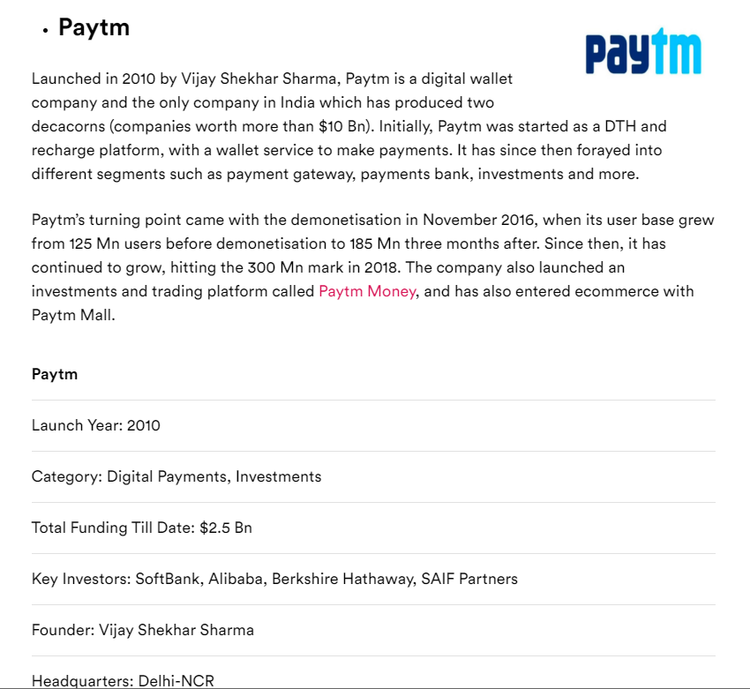
Mrs.Disha Wankhede Department of Computer Engineering, VIIT, Pune-48

Slide 6
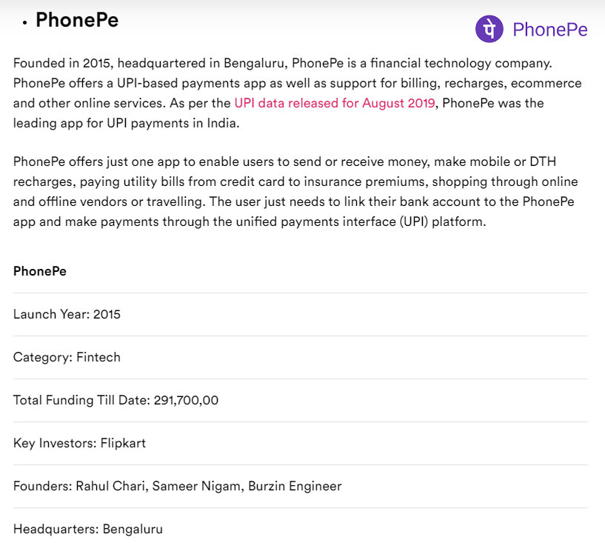
Mrs.Disha Wankhede Department of Computer Engineering, VIIT, Pune-48

Slide 7
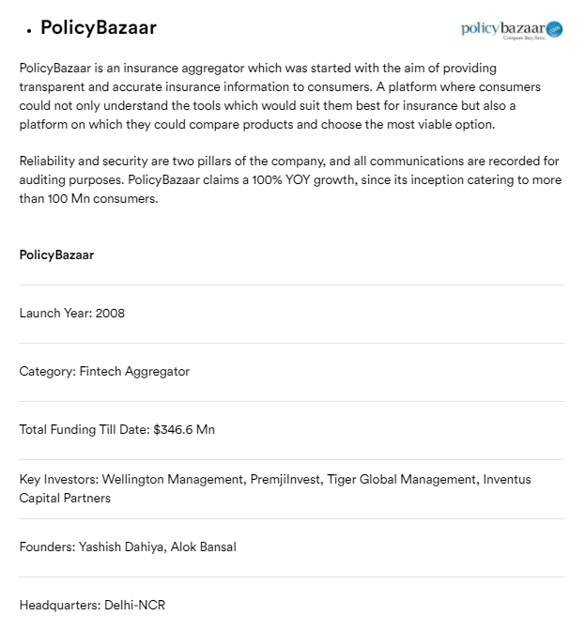
Mrs.Disha Wankhede Department of Computer Engineering, VIIT, Pune-48

Slide 8
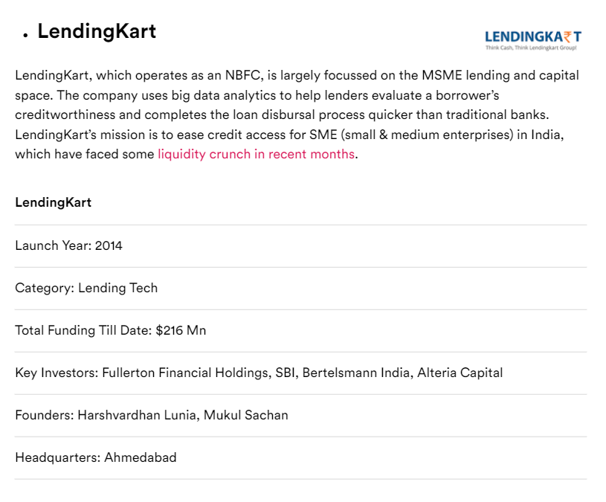
Mrs.Disha Wankhede Department of Computer Engineering, VIIT, Pune-48

Slide 9
Introduction
A business model to interpret how a fintech company should organize its business model.
where to focus and how to create a leading proactive mindset in this complex sector.
The model to help in the interpretation of different aspects of fintech initiatives.
Mrs.Disha Wankhede Department of Computer Engineering, VIIT, Pune-48

Slide 10
Fintech initiatives are concerned
1. Why a fintech initiative was born?
2. For whom was it born?
3. Which are the services it aims to provide?
4. Where does it aim to perform its business?
5. When does it aim to operate, within the framework of the financial cycle?
6. How is fintech working?
Mrs.Disha Wankhede Department of Computer Engineering, VIIT, Pune-48

Slide 11

Why Now?
Mrs.Disha Wankhede Department of Computer Engineering, VIIT, Pune-48

Slide 12
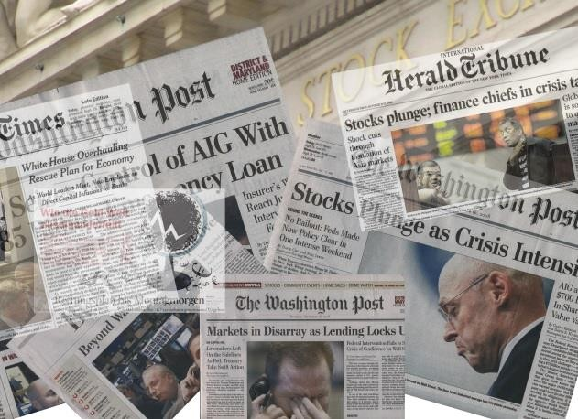
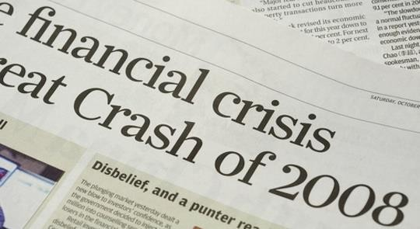
FinTech: Why NOW? (1/3)
Mrs.Disha Wankhede Department of Computer Engineering, VIIT, Pune-48

Slide 13
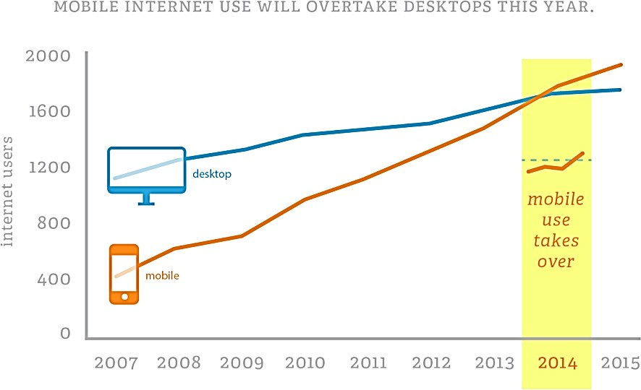
FinTech: Why NOW? (3/3)
Mrs.Disha Wankhede Department of Computer Engineering, VIIT, Pune-48

Slide 14
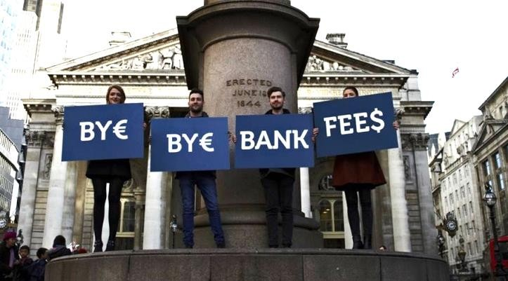

FinTech: Why NOW? (2/3)
Mrs.Disha Wankhede Department of Computer Engineering, VIIT, Pune-48

Slide 15
Why
In traditional financial institutions, there is a combination of a widespread difficulty of financial services to innovate with the internal resistance to change, typical of any organization.
The New entrance fintech startups.
The banking processes by delivering a better service to customer.
The fintech companies, stressing their great potential due to their knowledge, flexibility, and overall proposition value.
The second one focuses on financial institutions, stressing their still largely dominant customer base and economic strength.
Mrs.Disha Wankhede Department of Computer Engineering, VIIT, Pune-48

Slide 16
Why …Continue
The financial technology field may be identified in the inefficiencies of the traditional organizations
This usually happens for several reasons,the main ones being:
• The low appeal of some financial services due to their overall low
profitability
• The inefficiencies and the general lack of skills, capabilities, and will of
financial institutions to recognize and pursue new opportunities
Mrs.Disha Wankhede Department of Computer Engineering, VIIT, Pune-48

Slide 17
Model groups
Customer service, financial services, compliance,and business processes:
1. Customer service: processes and services that deal with the customer at the user interface level as well as at the backend database level:
• Customer relationship management (CRM)
• Call center software
• Electronic billing and payment technology
• Electronic trading and banking
Mrs.Disha Wankhede Department of Computer Engineering, VIIT, Pune-48

Slide 18
Model groups..Continue
2. Financial services: applications and processes for portfolio management and risk management:
• Portfolio management
• Asset management
• Risk management solutions
• Exchanges
Mrs.Disha Wankhede Department of Computer Engineering, VIIT, Pune-48

Slide 19
Continue
3. Compliance: methods for a company to comply with external and internal regulations:
• Financial statement reporting and analysis
• Trade clearing
• Compliance with regulations in one or more nations
Mrs.Disha Wankhede Department of Computer Engineering, VIIT, Pune-48

Slide 20
4.Business processes: Collections of linked activities with the objective to deliver a specific result:
• Application service providers
• Data warehousing and analytics
• Data quality
• Document management
• Imaging software
• Knowledge management
• System integration
• Security
• ICT infrastructure and outsourcing
Mrs.Disha Wankhede Department of Computer Engineering, VIIT, Pune-48

Slide 21
Who are FinTech Startups?
Mrs.Disha Wankhede Department of Computer Engineering, VIIT, Pune-48
11

Slide 22
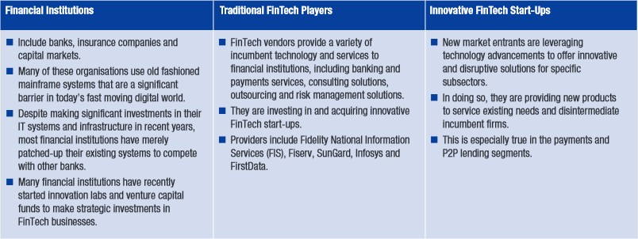
FinServ Co’s, ‘Old’ FinTech, ‘New’ FinTech
Source: affentranger associates (aasa)
Mrs.Disha Wankhede Department of Computer Engineering, VIIT, Pune-48

Slide 23
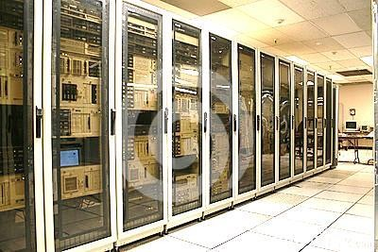

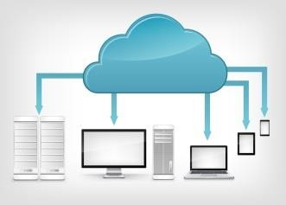

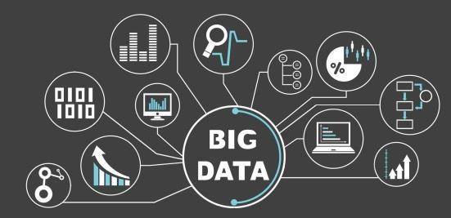
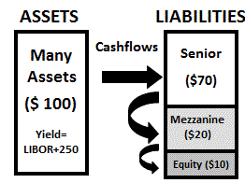







Fintech: Not So « New » (1/2)
The (19)80’s
1995-2000
2010-NOW
Mrs.Disha Wankhede Department of Computer Engineering, VIIT, Pune-48

Slide 24










Fintech: Not So « New » (2/2)
The (19)80’s
1995-2000
2010-NOW
Mrs.Disha Wankhede Department of Computer Engineering, VIIT, Pune-48

Slide 25
Fiserv, Inc. is a global provider of financial services technology. The company's clients include banks, thrifts, credit unions, securities broker dealers, leasing and finance companies, and retailers. Wikipedia
Stock price: FISV (NASDAQ) US$102.11 -0.07 (-0.06%) 18 Aug, 11:22 am GMT-4 - Disclaimer
CEO: Jeffery W Yabuki (1 Dec 2005–)
Headquarters: Brookfield, Wisconsin, United States
Number of employees: 44,000 (December 2019)
Founded: 31 July 1984, Brookfield, Wisconsin, United States
Subsidiaries: First Data, Clover Network, Open Solutions, MORE
Founders: George Dalton, Leslie Muma
Bloomberg L.P. is a privately held financial, software, data, and media company headquartered in Midtown Manhattan, New York City. It was founded by Michael Bloomberg in 1981, with the help of Thomas Secunda, Duncan MacMillan, Charles Zegar, and a 30% ownership investment by Merrill Lynch. Wikipedia
Revenue: 1,000 crores USD (2019)
CEO: Michael Bloomberg (31 Dec 2014–)
Founded: 1 October 1981
Headquarters: New York, New York, United States
Subsidiaries: Bloomberg Government, Bloomberg Industry Group, MORE
Founders: Michael Bloomberg, Thomas Secunda, Charles Zegar, Duncan MacMillan

Slide 26
Who
The center of the business model of fintech initiatives, there is a service.
The subsequent business relationship established through the service may have different forms depending on the nature of the subjects that are making use of it:
1. P2P—person-to-person services
2. B2P—business-to-person services
3. P2B—person-to-business services
4. B2B—business-to-business services
Mrs.Disha Wankhede Department of Computer Engineering, VIIT, Pune-48

Slide 27
P2P
P2P business model works, with reference to Lending Club and other credit companies, it is possible to consider the following simplified process
1. Borrower applies for a loan to the lending platform.
2. The lending platform commits to the borrower.
3. The lending platform informs the partner bank that the borrower is verified and investors have committed.
4. The partner bank issues the actual loan to the borrower.
5. The borrower sends a loan note to the partner bank.
6. The lender/investor gives cash to the lending platform.
7. The lending platform purchases the loan note using the lender’s/ investor’s cash from the partner bank.
8. The partner bank sends the loan note to the lending platform.
9. The lending platform sends the loan note to the lender/investor.
10. When the due time is reached, the borrower pays back the lending
platform, which then pays back the lender/investor
Mrs.Disha Wankhede Department of Computer Engineering, VIIT, Pune-48

Slide 28
B2P
The ATM is the typical example of B2P: the customer can easily access an ATM, withdraw money, and make a variety of financial transactions while consistently saving time and resources.
Cash apps like PayPal, Venmo and Apple Pay all allow clients or customers to transfer money via the internet or mobile technology, and budgeting apps like Mint allow customers to manage their finances and expenses.
Mrs.Disha Wankhede Department of Computer Engineering, VIIT, Pune-48

Slide 29
P2B
The second type of financial services are P2B ones.
Trading
Crowdfunding
Deposit
Virtual currencies
Insurance
Mrs.Disha Wankhede Department of Computer Engineering, VIIT, Pune-48

Slide 30
B2B
B2B services refer to the existing economic transactions between two
or more companies. Companies that are willing to establish business
Relationships with other companies with the aim of maximizing opportunities for both partners follow a B2B model.
Relationships between companies are complex and difficult to manage, but they are one of the best catalysts for innovation.
Mrs.Disha Wankhede Department of Computer Engineering, VIIT, Pune-48

Slide 31
Fintech initiatives follow a B2B model operates in the following areas:
• Money transfer
• Credit for SMEs
Provision of advanced services and packages to financial institutions
• Support for the internationalization of the businesses
• Other professional services to the businesses
Mrs.Disha Wankhede Department of Computer Engineering, VIIT, Pune-48

Slide 32
Before fintech was developed, businesses would go to banks to obtain loans and financing. But with the advent of fintech, businesses can easily get loans, financing, and other financial services through mobile technology.
Additionally, cloud-based platforms and even customer-relationship management services like Salesforce (CRM) - Get Report provides B2B services that allow companies to interact with financial data to help improve their services.

Slide 33
Why and How?
Mrs.Disha Wankhede Department of Computer Engineering, VIIT, Pune-48

Slide 34
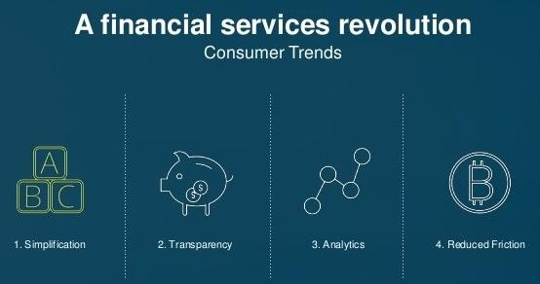
FinTech: Why They’re Doing It Differently?
Mrs.Disha Wankhede Department of Computer Engineering, VIIT, Pune-48

Slide 35
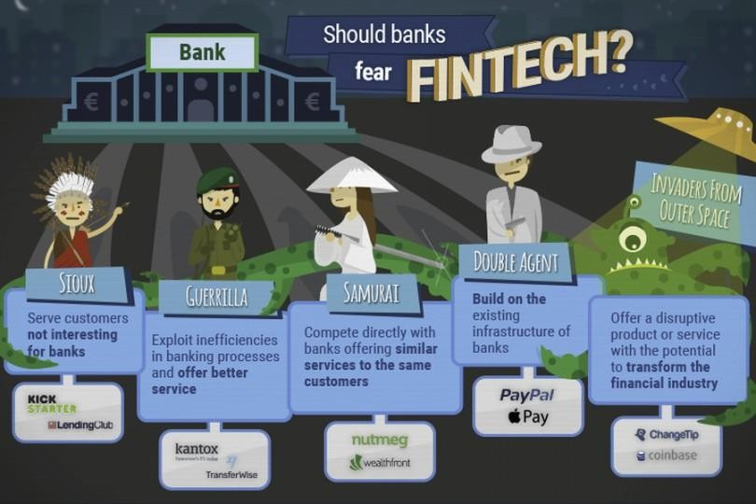
FinTech: How They’re Doing It Differently?
http://www.genbeta.com/actualidad/deben-los-bancos-temer-al-fintech
Mrs.Disha Wankhede Department of Computer Engineering, VIIT, Pune-48

Slide 36
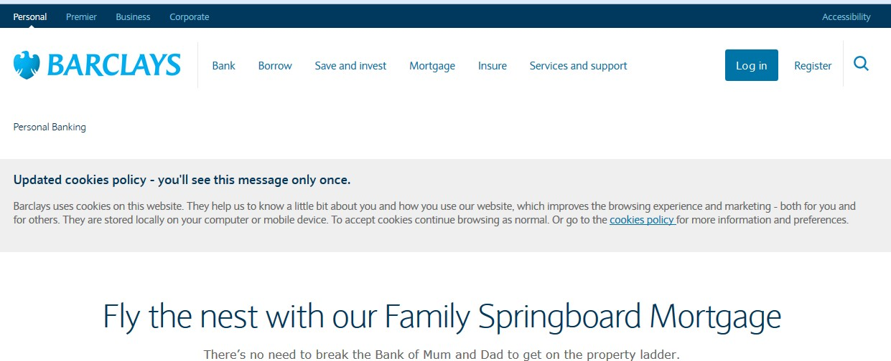
The Real Threat of FinTech: “Unbundling” The Bank (1/2)
Mrs.Disha Wankhede Department of Computer Engineering, VIIT, Pune-48

Slide 37



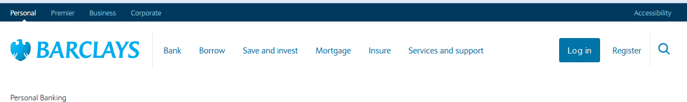





The Real Threat of FinTech: “Unbundling” The Bank (2/2)
"Unbundling" = the "process of breaking apart something into smaller parts"
Mrs.Disha Wankhede Department of Computer Engineering, VIIT, Pune-48

Slide 38
FinTech: Real Potential?
Mrs.Disha Wankhede Department of Computer Engineering, VIIT, Pune-48
24

Slide 39
Growth in FinTech? Bubble or Real Growth Potential? (1/2)
Mobile Payments
The global mobile payment market is on track to surpass $1 trillion in 2019(Ref-https://www.thestreet.com.)
Popular payment app Venmo.
Apple (AAPL) and Alibaba (BABA) got in on the mobile payment business with Apple Pay or Alipay.
Insurance
Insurtech startups are increasingly attracting funding, with insurance startup Oscar Health securing some $165 million in funding , in March of 2019 - at a $3.2 billion valuation, according to CNBC
Mrs.Disha Wankhede Department of Computer Engineering, VIIT, Pune-48

Slide 40
Fintech Stocks
There are plenty of exciting fintech stocks –
PayPal has long been a favorite on the market, even despite recent weak forecasts for 2019. In fact, PayPal racked up some 267 million users worldwide as of the end of 2018 - adding some 31% more accounts for the year.
Apart from the mobile cash app, there are several other fintech stocks catching analysts' eyes.
Visa (V) - is considered in the fintech space now, and analysts seem bullish on the stock's potential given the company's increasing shift toward plastic and technological advances.
Chinese behemoth Alibaba is consistently a big fintech stock to know - and potentially own. "Alibaba is years ahead of any competitor in driving digital commerce forward," said MKM Partners analyst Rob Sanderson last year.
Additionally, Zelle - the person-to-person (P2P) app developed in response to cash apps like Venmo - signals the banking industry's retaliation to fintech startups. The Zelle platform is backed by a variety of banks, including heavy-hitters like Bank of America (MER-K) , BB&T (BBT) , Capital One (COF) , JPMorgan Chase (JPM) , PNC Bank (PNC) , U.S. Bank (UBS) , and Wells Fargo (WFC)

Slide 41
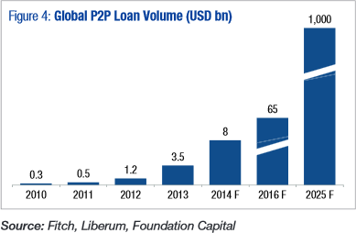
Growth in FinTech? Bubble or Real Growth Potential? (2/2)
x27
Mrs.Disha Wankhede Department of Computer Engineering, VIIT, Pune-48

Slide 42
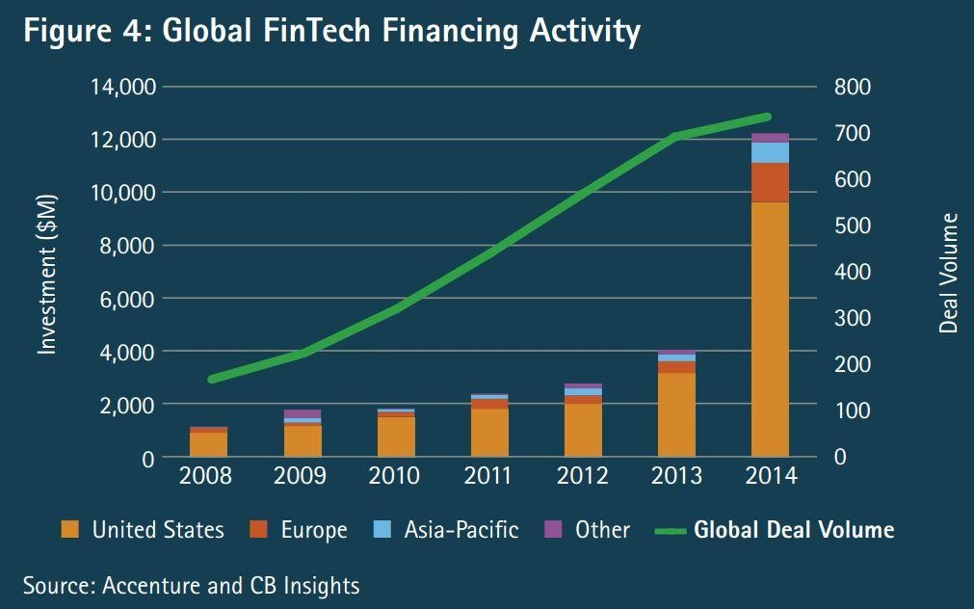
Funding Activity in FinTech Explodes!
Mrs.Disha Wankhede Department of Computer Engineering, VIIT, Pune-48

Slide 43
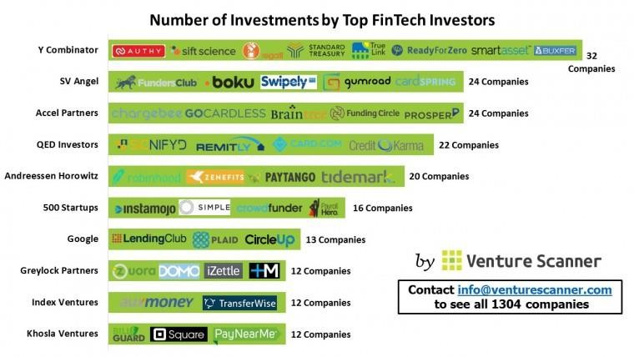
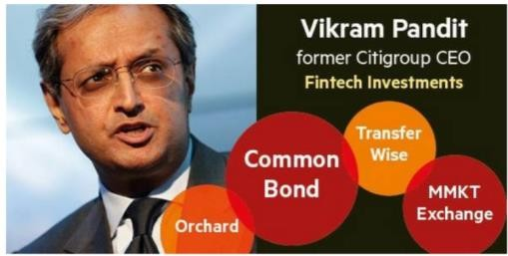
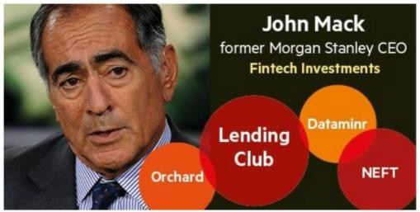
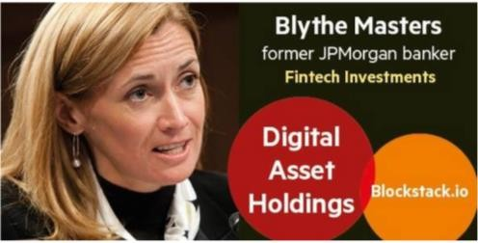
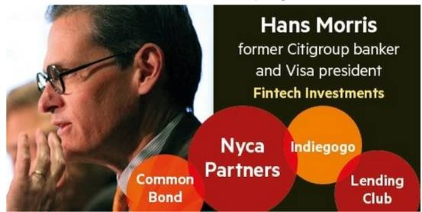
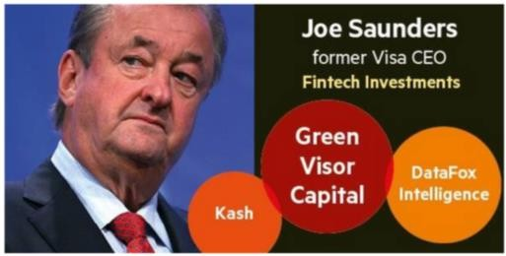
Another Proof of Concept? Follow the Smart ‘Guys’!
Mrs.Disha Wankhede Department of Computer Engineering, VIIT, Pune-48

Slide 44
How
How fintech initiatives are innovating and how are they planning to deliver their services,
Through software or other technology and includes anything from mobile payment apps to cryptocurrency.
Mobility (for instance, mobile banking)
• Big Data Analytics
• IoT
• Cloud computing
• Artificial intelligence (AI)
• Robotics
• Social networks, etc
Mrs.Disha Wankhede Department of Computer Engineering, VIIT, Pune-48

Slide 45
It is also possible to classify fintech initiatives from how they innovate based on:
• Product or service innovations
• Process innovations
• Organizational innovations
• Business model innovations

Slide 46
What
The classification based on “what” coincides with the area of specialization of the company, leading to this further
classification:
• Insurance
• Wealth management
• Payments
• Credit
• Crowdfunding
• Retail banking
• Security
• Currency and forex (foreign exchanges and remittances)
• Other
Mrs.Disha Wankhede Department of Computer Engineering, VIIT, Pune-48

Slide 47
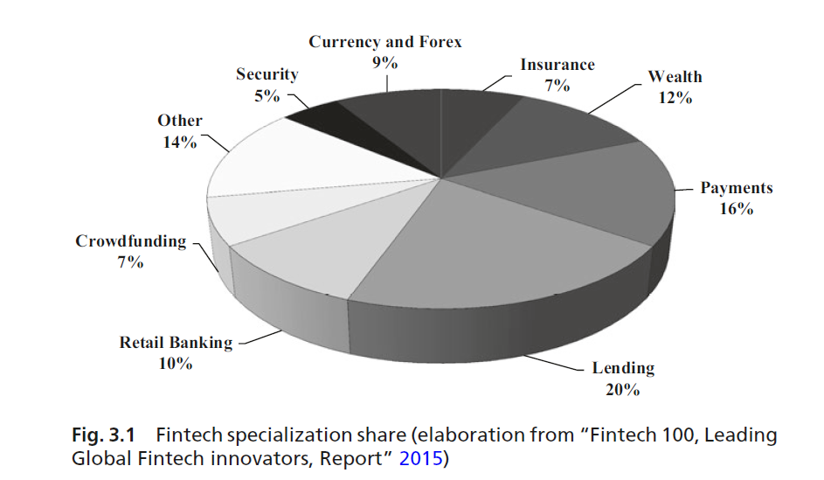
Mrs.Disha Wankhede Department of Computer Engineering, VIIT, Pune-48

Slide 48
Where: International landscape of FinTech startups
Mrs.Disha Wankhede Department of Computer Engineering, VIIT, Pune-48

Slide 49
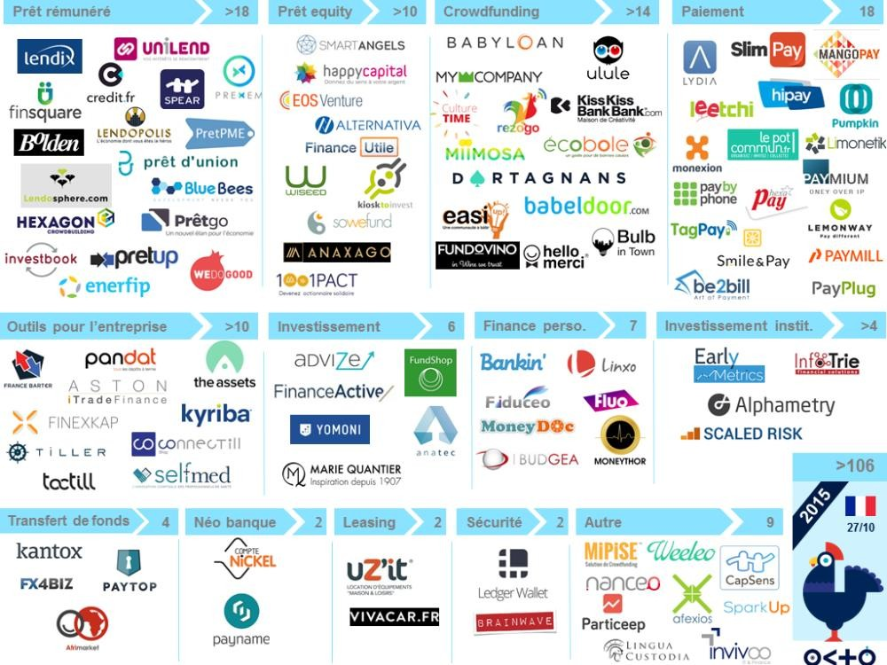
FinTech Landscape by Octo Technology
Mrs.Disha Wankhede Department of Computer Engineering, VIIT, Pune-48

Slide 50
where
The relationship between the business idea and its development,
fintech initiatives fall into one of the following classes:
1. Startups
2. Traditional financial institutions, such as banks or insurance companies
3. Technological or retail companies moving into financial services
4. Advanced startups with a mixed ownership
Mrs.Disha Wankhede Department of Computer Engineering, VIIT, Pune-48

Slide 51
When
Fintech may be classified into two categories according to “when” companies provide their services:
1. Traditional fintech
2. Emergent fintech
Mrs.Disha Wankhede Department of Computer Engineering, VIIT, Pune-48

Slide 52
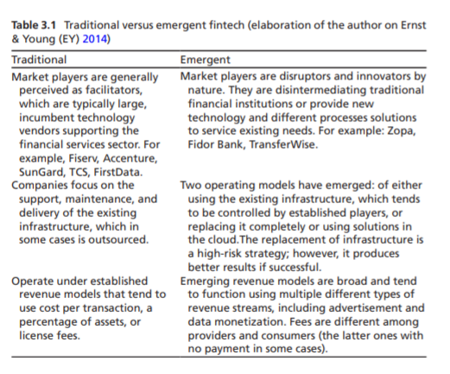

Slide 53
Example
The traditional infrastructure is a limit and an opportunity at the same time. PayPal, for instance, has built its business on the existing infrastructure, but at the same time, has delivered additional services to its customers.
Other companies, such as the already mentioned Kantox, use instead a completely different approach to the business, circumventing the old and established infrastructures (for instance, with a P2P business model).
Mrs.Disha Wankhede Department of Computer Engineering, VIIT, Pune-48

Slide 54
Unit 2 Contents
Part A :
Introduction,
Classification,
Five Ws and one H :
1. Why a fintech initiative was born?
2. For whom was it born?
3. Which are the services it aims to provide?
4. Where does it aim to perform its business?
5. When does it aim to operate, within the framework of the financial cycle?
6.How is fintech working?
Part B :
The organization and its elements,
The V4 business model framework,
A Business Model,
A Business Model for Fintech,
Revenue—Focus on Customer Lifetime Value, Components of an effective marketing plan.
Mrs.Disha Wankhede Department of Computer Engineering, VIIT, Pune-48
Mrs.Disha Wankhede Department of Computer Engineering, VIIT, Pune-48

Slide 55
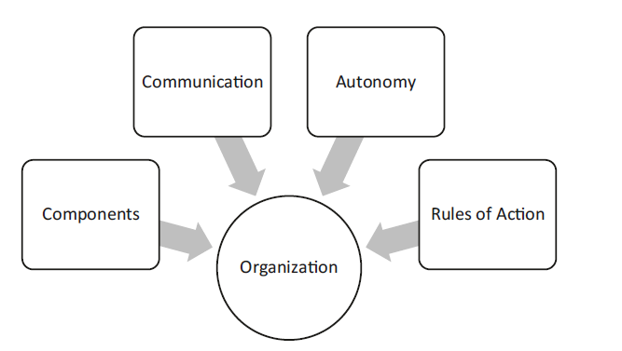
The organization and its elements
Mrs.Disha Wankhede Department of Computer Engineering, VIIT, Pune-48

Slide 56
Fintech initiatives are focusing their efforts on the production and delivery of leading-edge technologies that now serve their target markets as no traditional organizations did in the past.
Why was fintech born? For whom was it born? What product does it aim to provide? Where and when does it intend to perform its business? How is fintech working?. It also provides multiple classifications from different perspectives.
By using a visual framework for analyzing a business model (BMC), describes a model that aims to support those fintech initiatives aiming to achieve a competitive advantage in this fragmented galaxy.
The statements provided are general guidelines and need further adaptations for being successful.

Slide 57
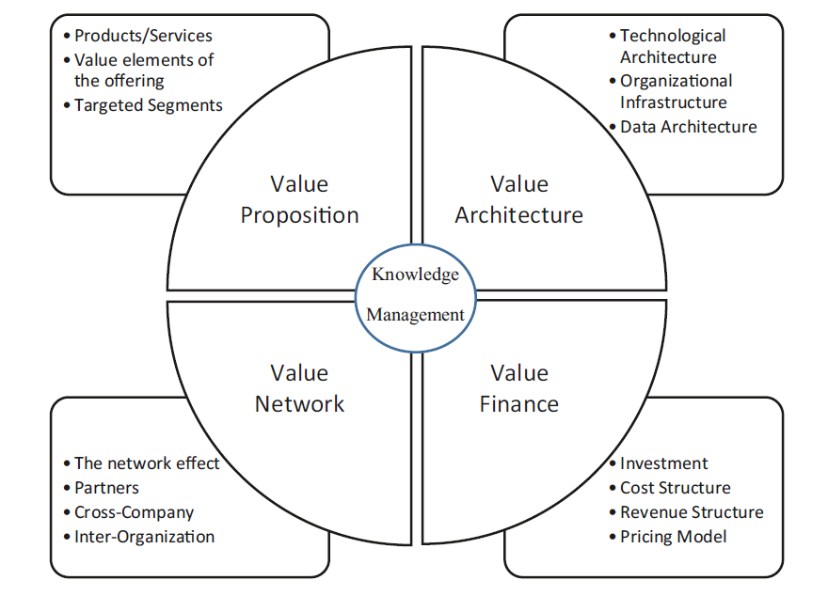
The V4 business model framework
Mrs.Disha Wankhede Department of Computer Engineering, VIIT, Pune-48

Slide 58
3 Ps
Peer relationships
• Balance sheet lenders
• Marketplace lenders
• Hybrid model
Financial products
• Revolving lines of credit
• Merchant cash advances
• Unsecured term loans (3–8 months)
Mrs.Disha Wankhede Department of Computer Engineering, VIIT, Pune-48

Slide 59
Processes
• Direct flow
• Mediated flow
Mrs.Disha Wankhede Department of Computer Engineering, VIIT, Pune-48

Slide 60
A Business Model : The Business Model Approach
Every startup should address its focus toward nine important elements:
1. Market—focus on targets
2. Products and services—focus on value added
3. Channels—focus on social and omnichannel
4. Customer experience—focus on customer-centric approach
5. Revenue—focus on customer lifetime value
6. Processes and activities—focus on marketing
7. Resources and systems—focus on technology
8. Partnership and collaboration—focus on financial institutions
9. Costs and investments—focus on risks
Mrs.Disha Wankhede Department of Computer Engineering, VIIT, Pune-48

Slide 61
Prediction
The market size of the Fintech sector is going to be worth US$26.5 trillion in 2022.

Slide 62
Why Invest in Fintech App Development in 2019-2020?
1.Easier Payment Process
2.Evaluating Risks Effectively
3.Faster Investment
4.Lower Cost

Slide 63
Reasons That Make Fintech a Good Investment Avenue
1. Fiat currency is becoming digital
2. Data has become the new oil
3. Your mobile is your wallet
4. The social impact
5. Fintech industry acquirers tend to have deep pockets

Slide 64
FinTech App Development Trends for 2020 & Beyond
There are a number of technologies and trends that will become more apparent in Fintech realm in 2019-2020 and foster innovation in different business verticals. Such as –
1.Blockchain will Become a Prominent Part of Fintech Strategy
2.AI will Enhance Financial Consumer Strategy
3.New Payment Solutions will be Introduced
4.CyberSecurity will Get More Attention
5.Digital-Only Banks will Gain Momentum
6.Higher Investment Will be Made in Fintech

Slide 65
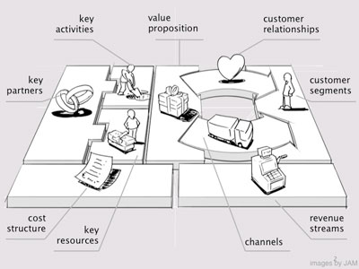
9 Most Important Elements of a Business

Slide 66
1. Value Proposition: the product/service, its features and benefits or uniqueness vs. competition; size of the market opportunity; customer feedback early.
2. Customer Segments: who your customer is and what problems the product solves .
3. Channels: how you’ll distribute and sell your product.
4. Customer Relationships: how you’ll create demand .
5. Cost Structure: the fixed and variable costs required to operate your business .

Slide 67
6. Key Activities: the tasks the company must perform to succeed.
7. Key Resources: suppliers, commodities, or other essential elements of the business .
8. Key Partners: other enterprises essential to success of the business .
9. Revenue Streams: revenue and profit sources and size.

Slide 68


Slide 69
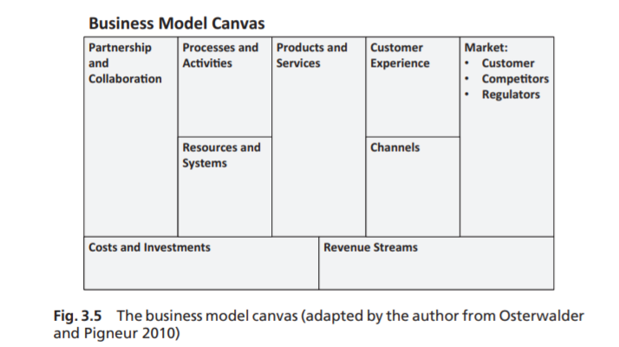

Slide 70
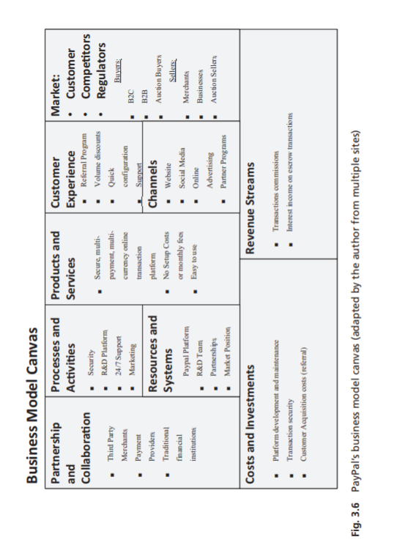

Slide 71
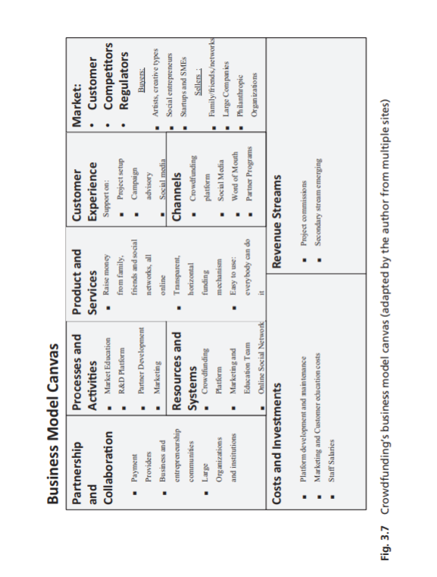

Slide 72
survey has found that the top
five elements influencing loyalty in consumer banking are (Almquist
et al. 2016):
• Assure quality
• Provides access
• Continue tradition
• Avoids hassles
• Reduces anxiety
In the case of auto insurance, the survey found that the following elements
influence loyalty (Almquist et al. 2016):
• Assure quality
• Reduces anxiety
• Reduces cost
• Provides access
• Provide variety
Mrs.Disha Wankhede Department of Computer Engineering, VIIT, Pune-48

Slide 73
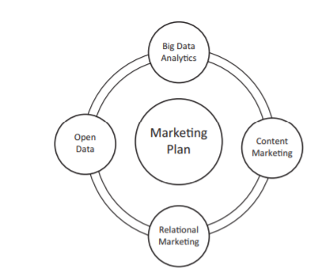
Components of an effective marketing plan

Slide 74
Big Data Analytics: New software products and tools have entered the market, making Big Data (both structured and unstructured) far more accessible, even for little startups.
2. Open data: Data publicly available with no restrictions from ownership, patents and copyrights
3. The other 3 Cs: Customized Customer Content. This is about putting in action marketing promotions leveraging on social media channels.
Accenture’s Banking blog is an example of how this can have a great impact on the company’s lead generation. Marketing Plan Big Data Analytics Content Marketing Relational Marketing Open Data Fig. 3.8 Components of an effective marketing plan
4. Relational marketing: The primary objective of a company should be the construction of loyal and long-term relationships with its customers. This task can also be accomplished by leveraging on social media channels, Big Data Analytics, and technology. The importance of customer knowledge management is particularly important both for the consumer and in the business financial market (Cui and Wu 2016).

Slide 75
Don’t ask what FinTech can do for you…
Mrs.Disha Wankhede Department of Computer Engineering, VIIT, Pune-48

Slide 76
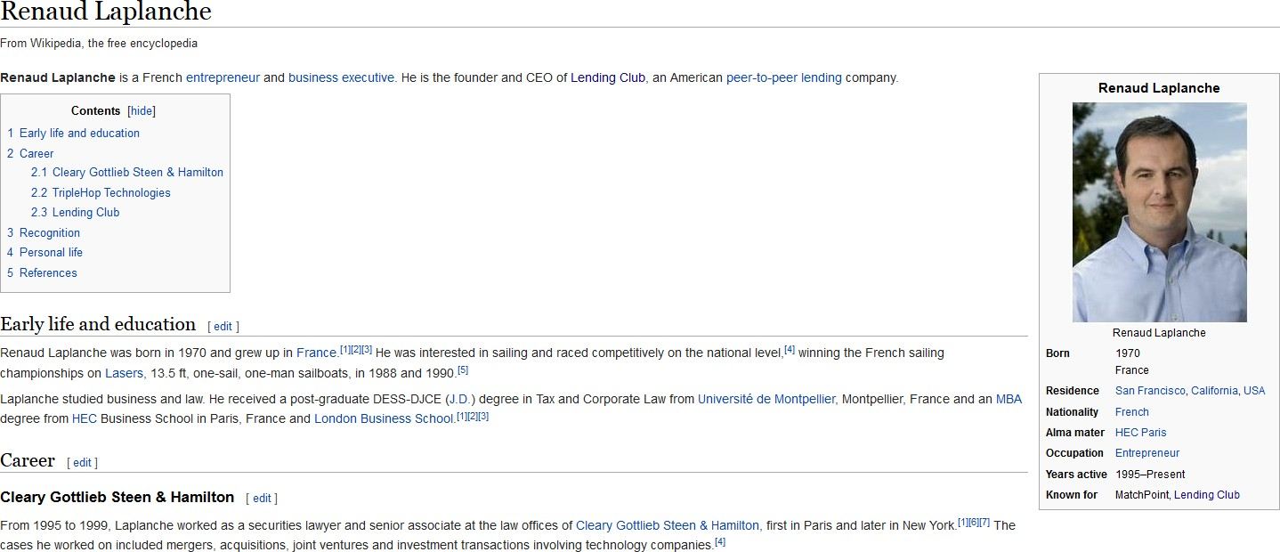
Few Examples of FinTech Entrepreneurs (1/4)
Source: Wikipédia
Mrs.Disha Wankhede Department of Computer Engineering, VIIT, Pune-48

Slide 77

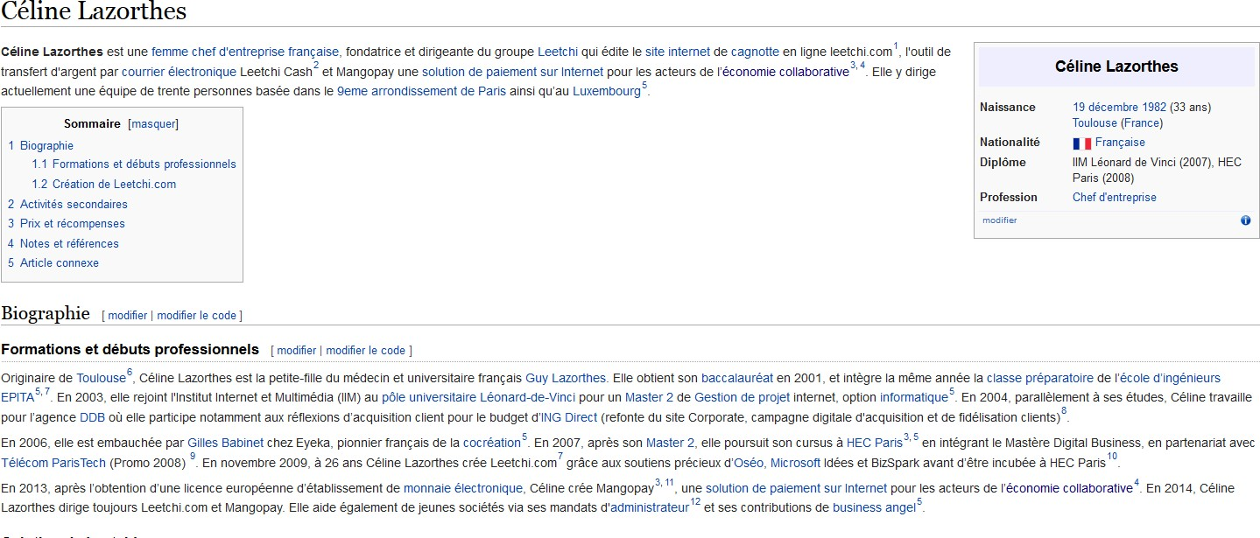

Few Examples of FinTech Entrepreneurs (2/4)
Source: Wikipédia
Mrs.Disha Wankhede Department of Computer Engineering, VIIT, Pune-48

Slide 78
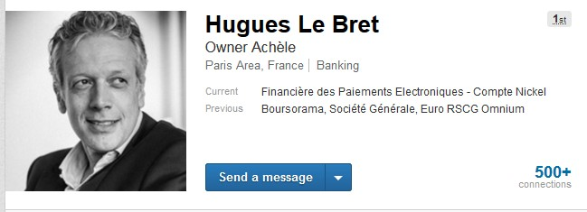
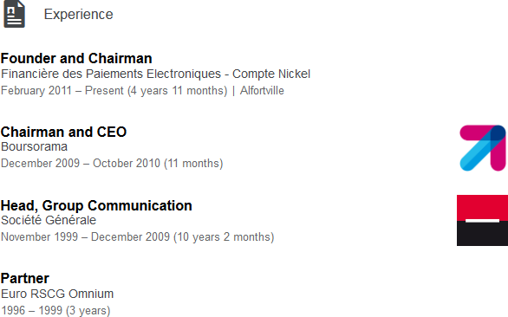
Few Examples of FinTech Entrepreneurs (3/4)
Source: LinkedIn
Mrs.Disha Wankhede Department of Computer Engineering, VIIT, Pune-48

Slide 79
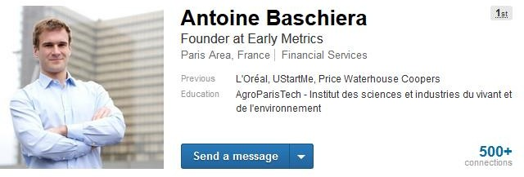
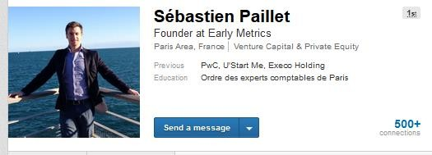
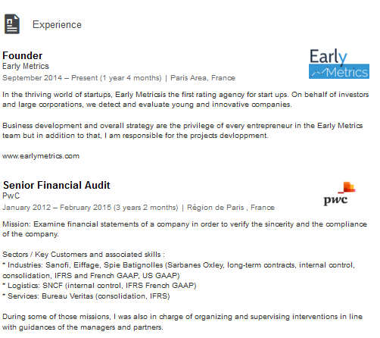
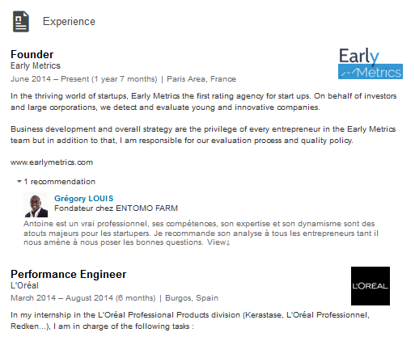
Few Examples of FinTech Entrepreneurs (4/4)
Source: LinkedIn
Mrs.Disha Wankhede Department of Computer Engineering, VIIT, Pune-48

Slide 80
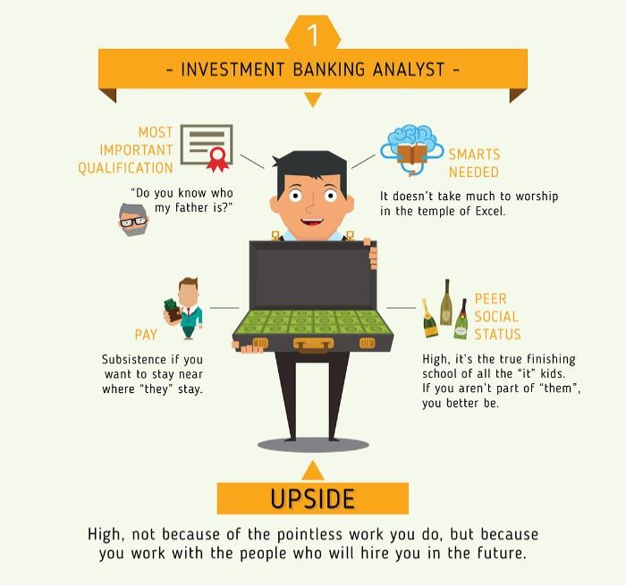

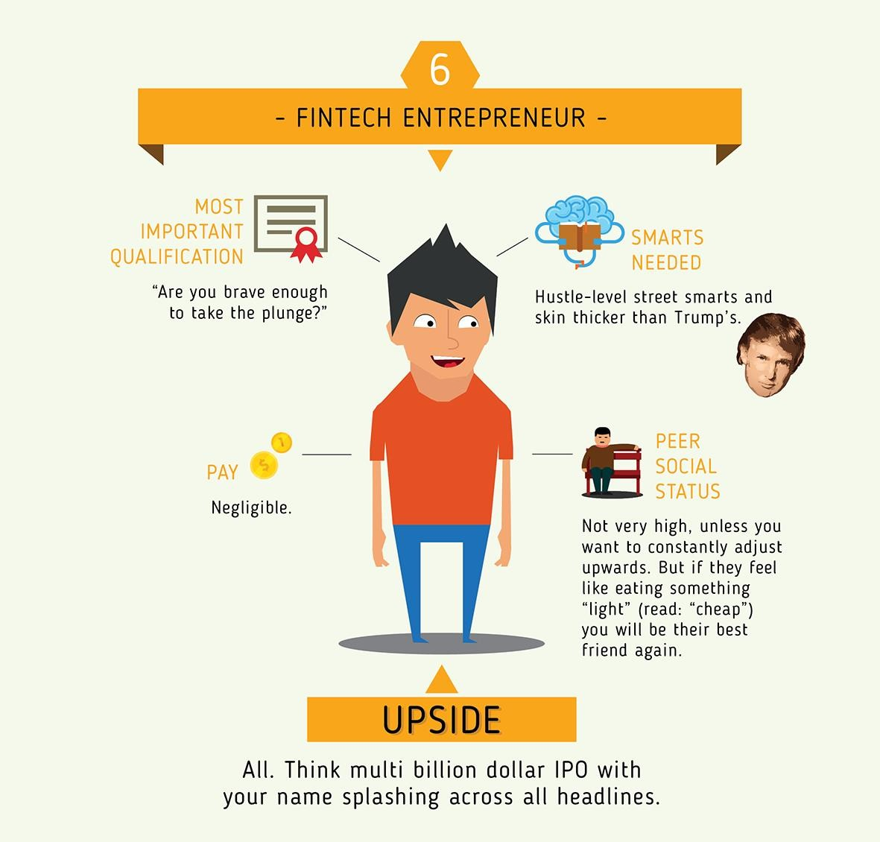
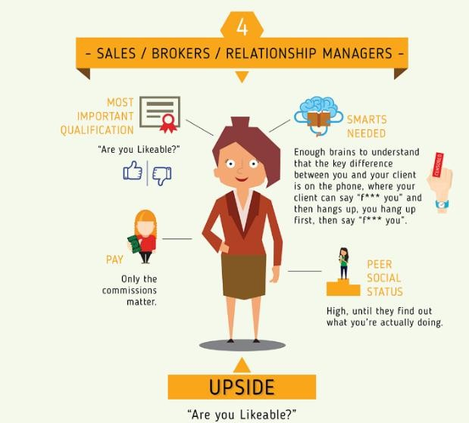

Being a FinTech Entrepreneur Can Pay Off
vs.
http://tech.co/fintech-entrepreneur-payoff-2015-12
Mrs.Disha Wankhede Department of Computer Engineering, VIIT, Pune-48

Slide 81
Further Insights
Mrs.Disha Wankhede Department of Computer Engineering, VIIT, Pune-48
41

Slide 82
Further Reading
"La (French) FinTech Connection" (Jean-Michel Pailhon)
"Fintech strategic review" by Jean-Michel Pailhon (SlideShare)
FinTech : concurrents ou partenaires - OCTO Technology
"Le FinTech cannibalisent la banque" (Octo Technology)
Groupe « Fintechers France » sur Linkedin
Twitter
La Banque, Reflet d'un Monde en Train de Naître (Octobre 2015, Athling)
http://www.francefintech.org/
https://www.cbinsights.com/blog/category/industry/fin-tech-industry/
Mrs.Disha Wankhede Department of Computer Engineering, VIIT, Pune-48

Slide 83


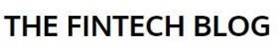


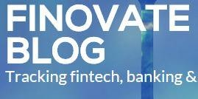

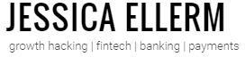



Fintech News Sites and Blogs (Sample)
C'est pas mon idée !
L'innovation dans les services financiers, par Patrice Bernard
Mrs.Disha Wankhede Department of Computer Engineering, VIIT, Pune-48

Slide 84
Reference
1. B. Nicoletti, The Future of FinTech, 1st ed. Palgrave Macmillan, 2017
2. Financial technology – Wikipedia
3. Albert Wang CTO, LionRock FinTech FINTECH: OVERVIEW
Mrs.Disha Wankhede Department of Computer Engineering, VIIT, Pune-48

